Slide 1
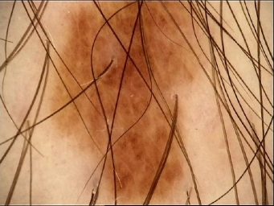
Skin Disease Detector
Evan Yeoh, Looi Yih Foo

Slide 2
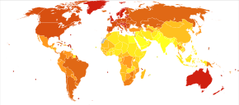
Introduction
Many skin diseases present defects visible to the eye
Melanoma – A deadly skin cancer
- Only 1% of skin cancer cases, but causes majority of deaths
Notes:
Melanoma – Focus of machine vision research by SIIM and ISIC. Common cause of cancer, especially in fair-skinned people
SIIM = Society for imaging informatic in medicine. ISIC = International skin imaging collaboration
Early treatment has >99% survival rate, but difficult to identify early
Sources:
https://www.skincancer.org/skin-cancer-information/melanoma/
https://www.aimatmelanoma.org/about-melanoma/melanoma-stats-facts-and-figures/

Slide 3
Issues faced during diagnosis

Slide 4
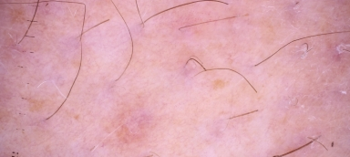
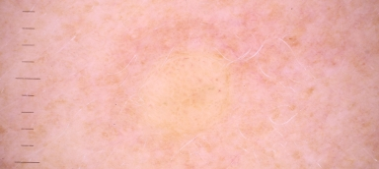
1. Difficult to detect
Where’s the defect?
Notes:
Typical problem: Mark is lightly coloured, blends with skin (dark = dark skin , light = light skin)
top: seborrheic keratosis. Slightly white-brown spot
bottom: melanoma. Slightly yellow spot

Slide 5
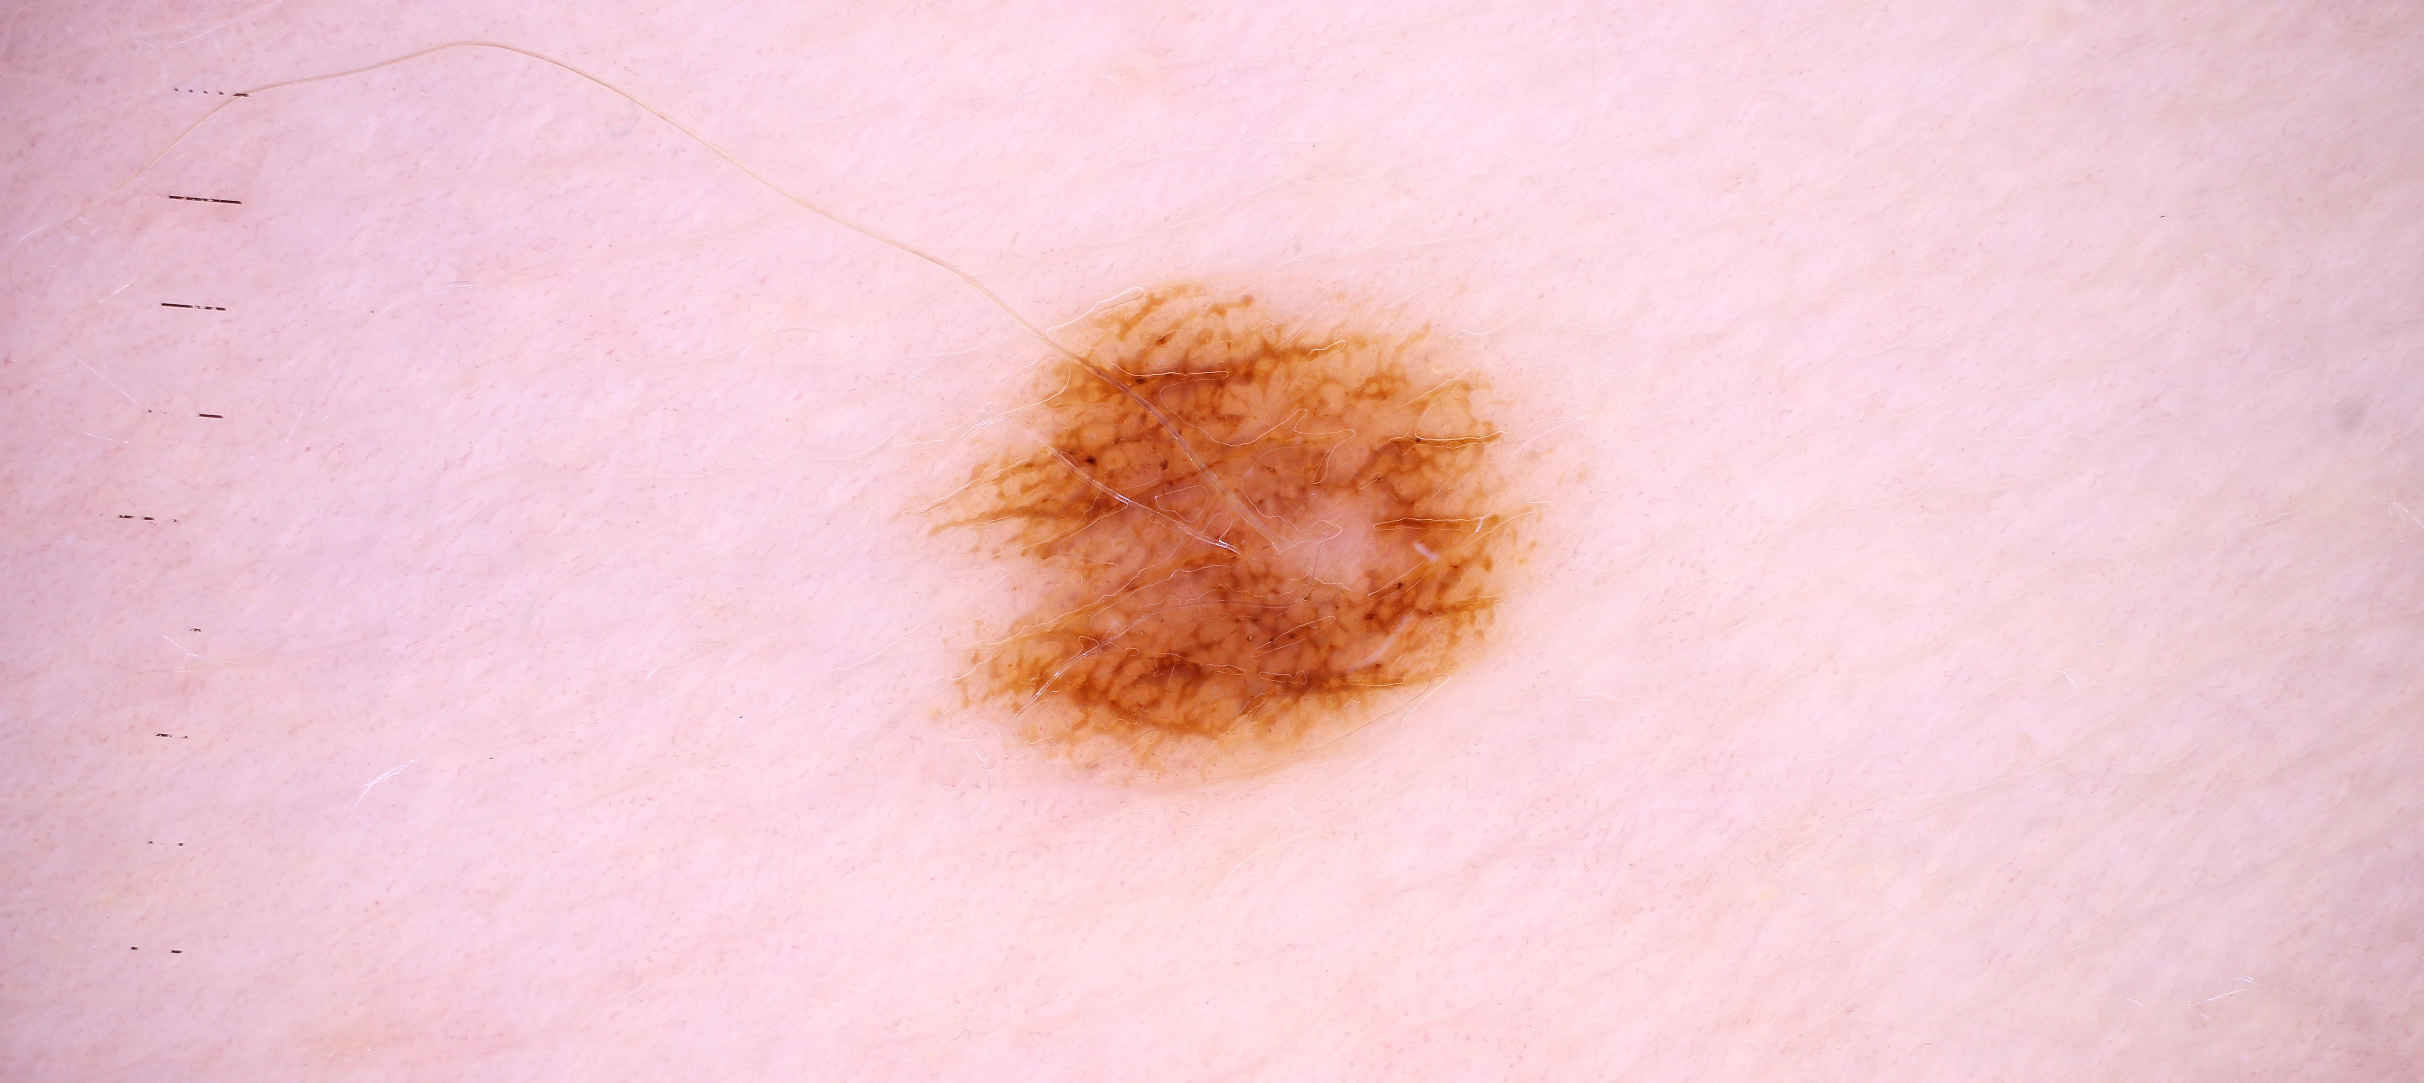
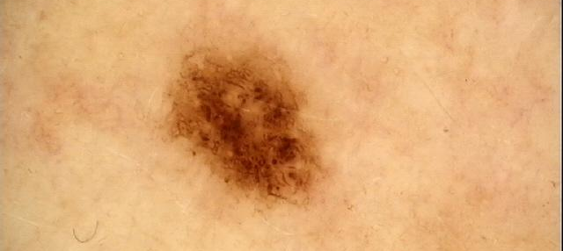
2. Difficult to distinguish
Which one is harmless, and which is cancer?
Notes:
Different skin conditions can present almost the same markings
An algorithm must consider tiny differences while accounting for image conditions (lighting, skin colour)
top: nevus – harmless mole
bottom melanoma – skin cancer

Slide 6
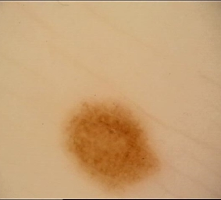
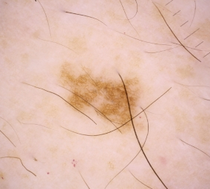
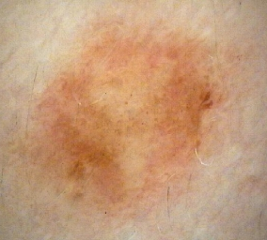
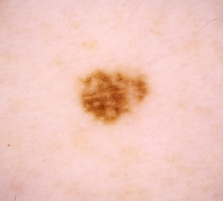
3. Many similar examples to compare
Need to rule out possible answers
Notes:
Doctors do differential diagnosis to rule out possible suspects.
Shortening the list of candidates helps process
Prevent unnecessary expensive or invasive testing (biopsies)
top left: lichenoid keratosis
top right: nevus
bottom left: melanoma
bottom right: lentigo nos

Slide 7
The idea
Gather data of common skin defects
Train YOLO model to detect differences in skin defects, and compare vs other common skin defects
Test model’s performance against a set of test data and in real life with input from a digital camera
Notes:
Gather data of common skin defects
Train YOLO model to detect differences in skin defects, and compare vs other common skin defects
Test model’s performance against a set of test data and in real life with input from a digital camera
3 skin defects considered: Melanoma, moles (nevus), and seborrheic keratosis (old age moles)

Slide 8
The journey – Data collection
Bulk of data from past Kaggle challenges But biased: Data on moles (nevus) far more than melanoma, seborrheic keratosis
Needed to scrape additional data from Google Images
Sources: https://www.kaggle.com/c/siim-isic-melanoma-classification/overview https://www.kaggle.com/wanderdust/skin-lesion-analysis-toward-melanoma-detection
Notes:
Bulk of data from past Kaggle challenges
- Prior competitions held (by ISIC) provides ready-made databases. But data highly skewed towards moles: >60%
Dataset is skewed towards nevus-es (moles). Needed to scrape additional data from Google Images
Solution? Undersample nevus, oversample melanomas and old age moles
Made up for missing data for melanomas and old-age moles using Google Images
- By the end, had 600 images for each of these output classes

Slide 9
The journey – Annotation
Data annotated using labelImg (https://github.com/tzutalin/labelImg)
Labels stored as PascalVOC .xml

Slide 10
The journey: Data processing
Images came in various sizes Solved by resizing with Windows 10 Image Resizer
Images came jumbled together, but with a CSV showing which image represents which skin defect Sorted using Python script

Slide 11
The journey: Architecture and modelling
Model: YoloV2
Modifications: Shape of YOLO model output layer conv2d_23. This is to accommodate 3 output classes Adjusted epochs & batch size to reduce loss score Maximised threshold to remove low-confidence predictions but preserve meaningful predictions

Slide 12
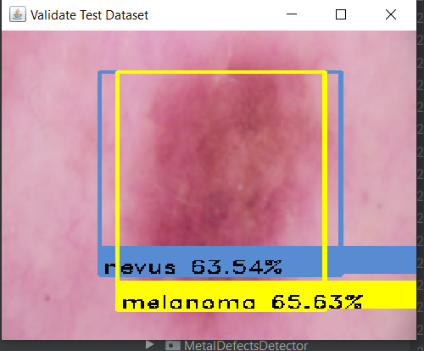
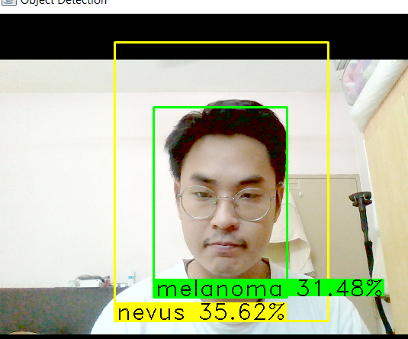
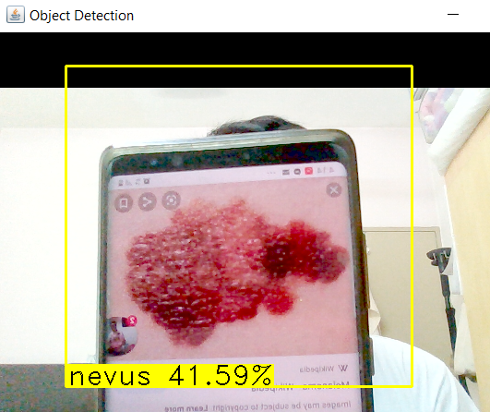
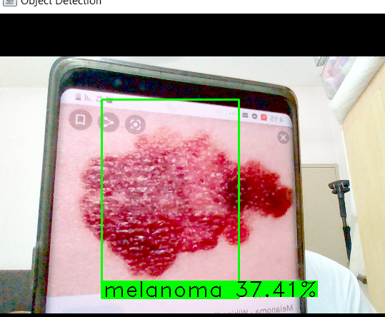
Difficulties
Imbalance Data Set :
Initially objective is to create a YOLO model that able to detect 5 classes of skin cancer. Due to the skew of data, had to remove classes that have small quantity of image(number image<100)
Overfitting in certain classes:
Some of the skin cancer class contain more data than others, Hence , balanced data for all classes is created in train ,test, and validation dataset by adding (oversampling) or remove (undersampling) some data.
Exceptional cases :
Predict 1 image into
2 classes:
Human face detect as cancer
Change of angle in image may confuse the model.
Notes:
Video shows model examining nevus

Slide 13
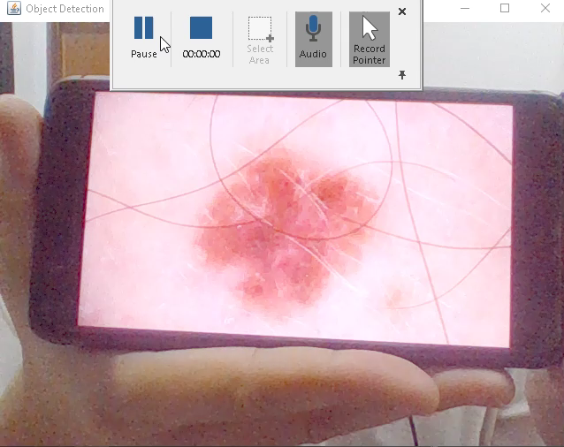
The journey: Evaluation
Post-build evaluation using test data. Makes up 10% of entire dataset.
Webcam test using on-screen images
Notes:
Video shows model examining nevus

Slide 14
Possible improvements
More data for each category of skin defect
More skin defect categories that have similar appearance
Notes:
More data for each category of skin defect
Allows model to generalise better to each skin defect
More skin defect categories that have similar appearance
To allow model to rule out other skin diseases that cause similar defects

Slide 15
Thank you!

